Slide 1
Newton’s First Law of Motion
The Law of Inertia

Slide 2
Remembering Uniform Motion
What is the net force on a 10 Kg object moving at a constant velocity of 10 m/s?
What is the acceleration?
a = 0 m/s² (uniform motion)
What is the net force?
F = m x a
F = 10 Kg x 0 m/s²
F = 0 N

Slide 3
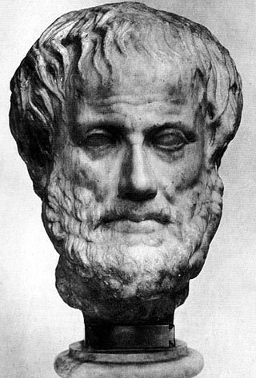
History: Aristotle: Greek philosopher (~300 BC)
• Believed objects naturally stay at rest and that force must be applied to keep an object moving
• His view held for over 1000 years
• He was unaware of the invisible force of friction!!

Slide 4
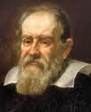
Galileo Galilei: Italian astronomer (~1542-1642)
Imagined a ball rolling down a smooth inclined ramp and up another inclined ramp

Slide 5
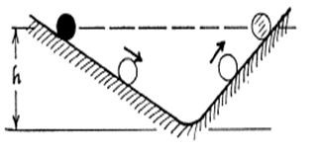
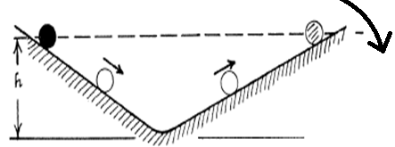
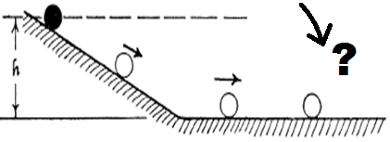
Ball rolls up to
same height
2) Lower the ramp-
Ball rolls to
SAME HEIGHT
but
FARTHER DISTANCE
3) Lower ramp to horizontal ..
what happens?
The ball will continue rolling FOREVER!!

Slide 6
• Galileo’s Conclusion: the ball will keep moving forever as long as no unbalanced force acts on it
The ball keeps rolling because of its
INERTIA.
INERTIA: the property of a body that resists a change in its state of motion
• Inertia depends directly on a body’s mass
inertia α mass

Slide 7
Inertia
The inertia of an object is related to its mass
Heavy objects have more inertia
Principles of inertia:
An object at rest will resist motion
An object in motion will resist acceleration
An object in motion will resist changes of direction

Slide 8
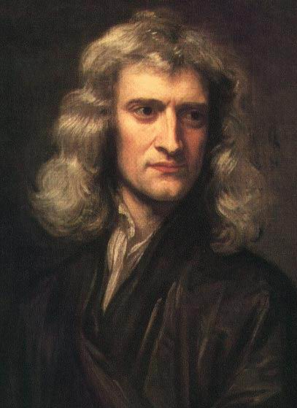
Isaac Newton (1642-1727)
• Incorporated Galileo’s Law of Inertia as his First Law of Motion

Slide 9
Newton’s First Law of Motion
• An object at rest or moving at constant velocity will maintain that state of motion UNLESS it is acted upon by an unbalanced force
object stays at rest
If Σ F = 0 THEN or
continues moving at constant velocity

Slide 10
Newton’s First Law of Motion
An object will continue being at rest unless acted upon by a non-zero net force
An object will continue moving at constant velocity unless acted upon by a non-zero net force
Applies When F_{net} = 0

Slide 11
Newton’s 3 Laws
First Law: an object at rest tends to stay at rest, and an object in motion tends to stay in motion, with the same direction and speed
Second Law: F = ma
Third Law: for every action (force) there is an equal and opposite reaction (force)

